Slide 1
Lab3

Slide 2
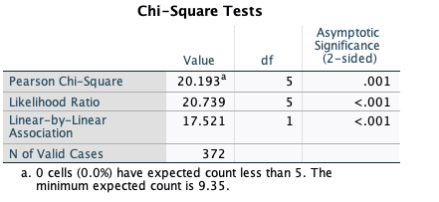
The result is not reliable if count is less than 5

Slide 3
“If a pair of values is significantly different, the values have different subscript letters assigned to them” (IBM SPSS)

Slide 4
“If a pair of values is significantly different, the values have different subscript letters assigned to them” (IBM SPSS)

Slide 5
“If a pair of values is significantly different, the values have different subscript letters assigned to them” (IBM SPSS)

Slide 7
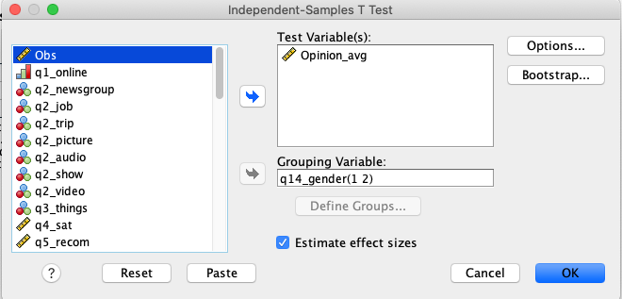

Slide 8
The std. deviation is helpful in understanding the Levene’s test results reported in the second table.

Slide 9
Block 1
Block 2

Slide 11
Lab4

Slide 17
Means of the same column are not significantly different. Mean of no-MBG group ≠ mean of 30 days group because they are not in the same column.
P-value (or sig.value) of no-MBG group vs. 15-days group

Slide 18
Complex Experiment

Slide 23
Regression

Slide 24


Slide 25
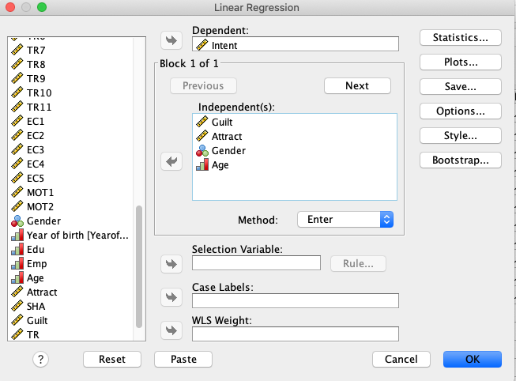

Slide 27
t = B / Std. error
If p-value is less than 0.05, t value is large, the associated variable is significant (null hypothesis is rejected).
If p-value is larger than 0.05, t value is small, the associated variable is significant (null hypothesis is not rejected).
For 1-sided test, p-value <=0.05, corresponds to t >= 1.64. Either reading the t column or Sig. column, you will arrive at the same conclusion

Slide 29
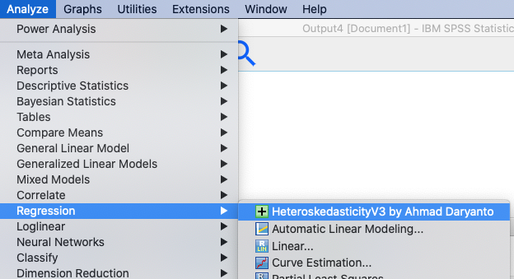

Slide 30
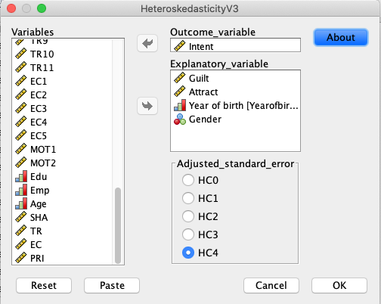

Slide 31


Slide 32
Mediation

Slide 33
Error 1
Environmental concerns
c
Intention
Anticipated Guilt
a
b
Error 2
Environmental concerns
Intention
c’

Slide 34
Environmental concerns
?
Intention
Anticipated Guilt
?
?
Environmental concerns
Intention
?

Slide 35
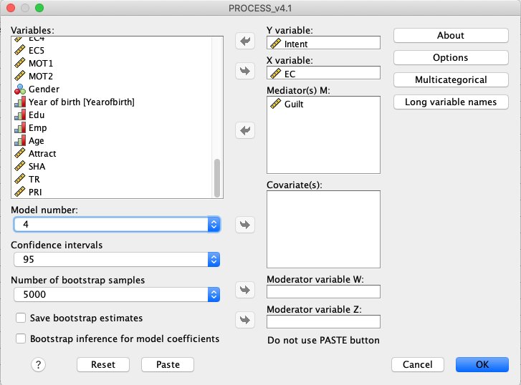
The, X, M, and Y variable
Change Model number to 4
95% Confidence interval
Leave the default number as it is

Slide 36
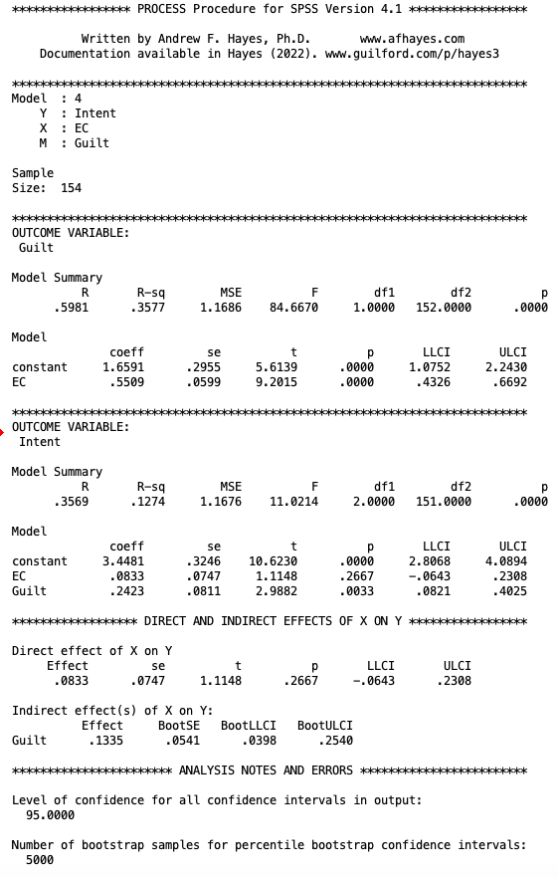
Indirect effect = mediation effect of EC via Guilt.
Size of mediation effect = 0.1335
The bootstrap confidence interval does not include zero, therefore the mediation effect is significant

Slide 37
Indirect effect = mediation effect.
Size of mediation effect = 0.1335
The bootstrap confidence interval does not include zero, therefore the mediation effect is significant

